Slide 1


B
L
P
BERLOPA
Presentation 2024
LOGO PRESENTATION
.
.
DANIEL BERNADAZ
JC LOPEZ
MARTIN PABELLON

Slide 2


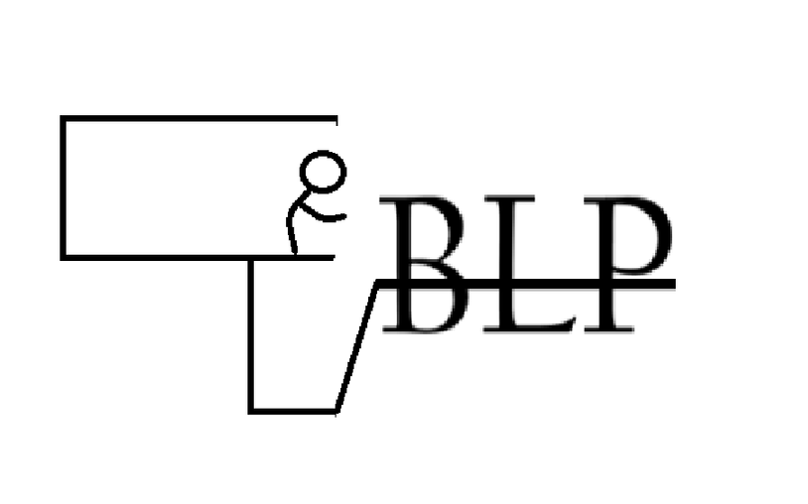
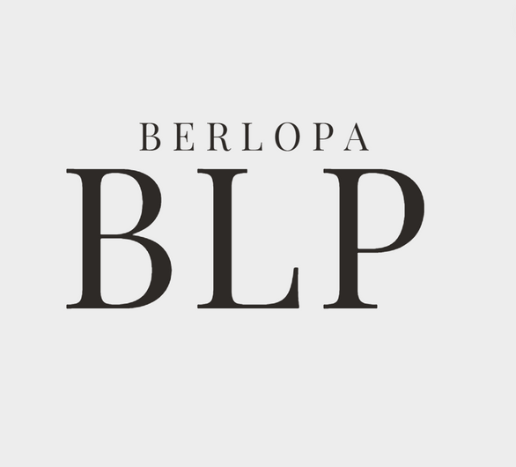
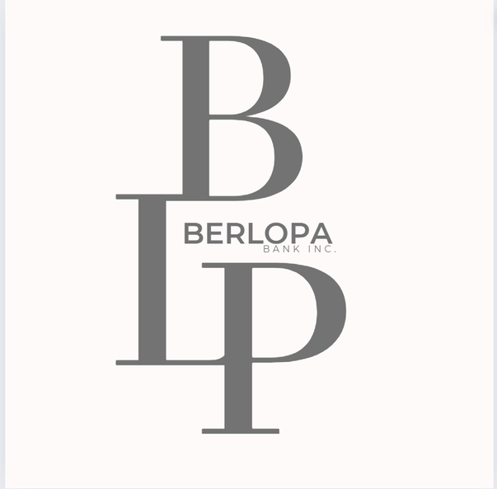
Team logo
LOGO 1
LOGO 2
LOGO 3

Slide 3
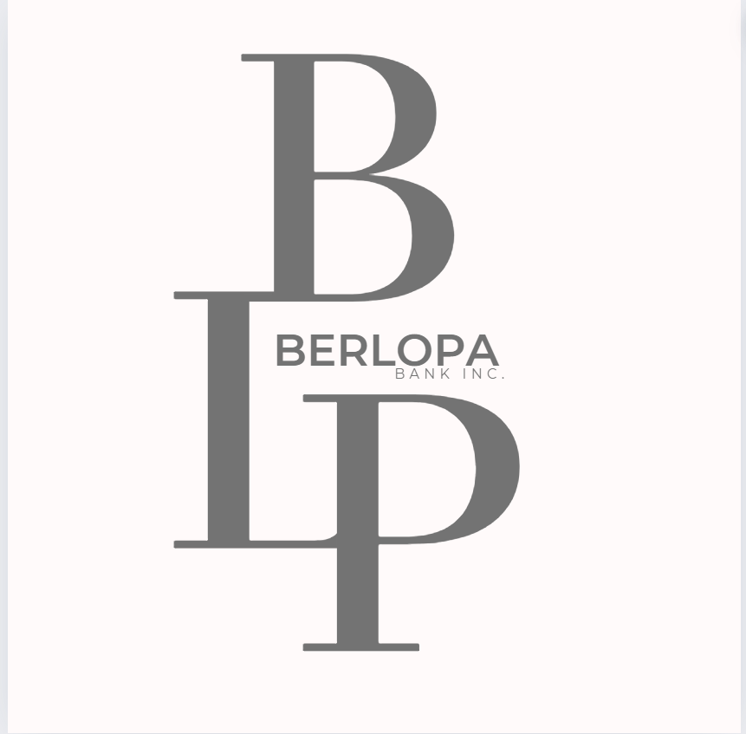
01
The logo presents the combined name of its founding team members which are, “Bernadaz”, “Lopez”, “Pabellon”
Using simplistic design that can easily help readers to distinguish what the logo is while maintaining a unique design enough to be remembered
02
The use of connected letters symbolizes a continuity within the connection with its users while also symbolizing unity within the group. The stacking of the words is a simple nod to our goals of high achievements.
03
Laws used: Continuity | Proximity | Symmetry | Similarity

Slide 4
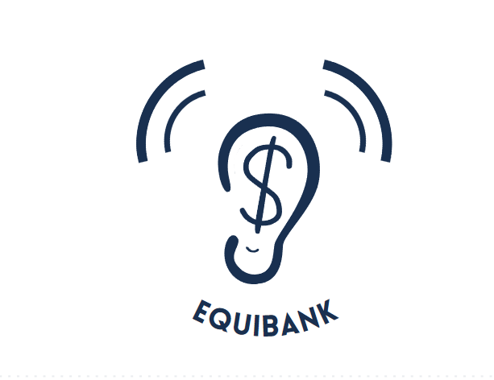

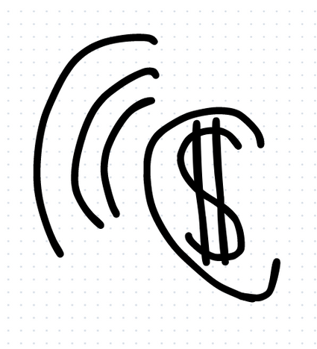
Equibank Icon
Proposed Icon #1
Proposed Icon #2
Proposed Icon #3

Slide 5
01
The Icon gives you the idea that the software would listen to your banking transactions, hence the ear with a dollar sign integrated into its design.
02
The symmetry with the sound waves and the Equibank name makes it have a circular pattern surrounding the ear
The icon is simple and straight forward. Its design’s were made to ideally focus the attention on money and banking as a whole
03
Laws used: Symmetry | Closure | Proximity |

